Slide 1

Hackathon
Mental Health in Tech
Group 14:
Beatriz Feijoo Gomez
Mahendra Kaswan
Vasundhara Sharma

Slide 2

Introduction
OSMI Mental Health in Tech Survey 2014, 2016 & 2019
Measuring attitude of employees & employers towards mental health.
20%
27
1,260
IT workers find it difficult to adjust
Attributes Evaluated
Respondents

Slide 3


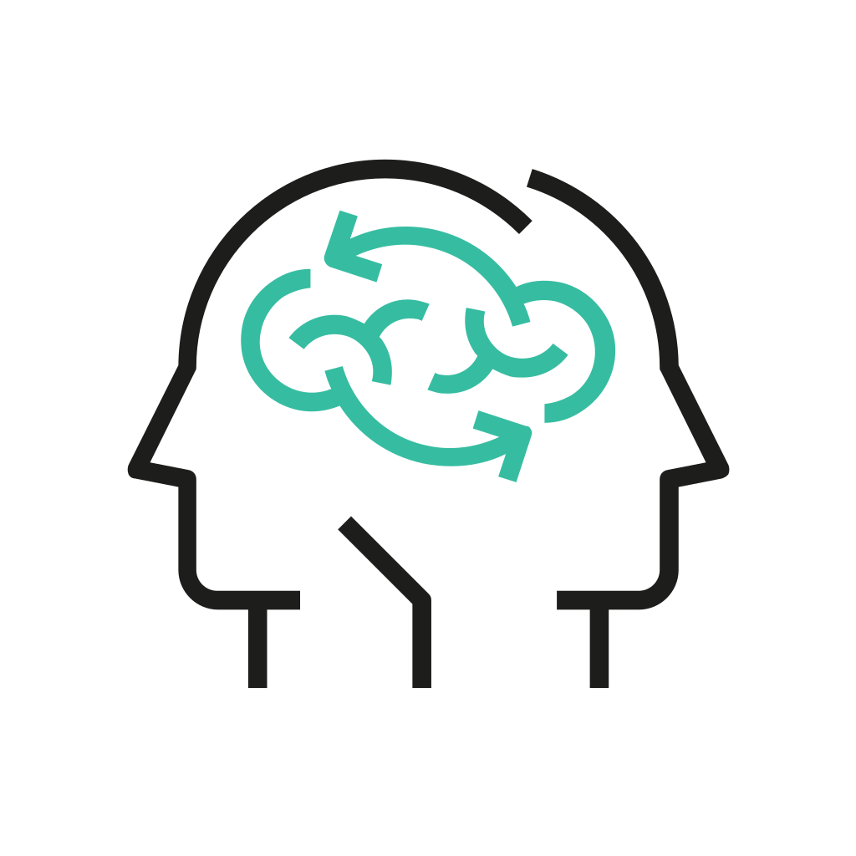


Methodology
Data Wrangling
Understanding the Respondents
Factors Affecting Mental Health of Employees
Analyzing Employee & Employer Mindset
Sentiment analysis of comments

Slide 4
Understanding the Respondents

Slide 5

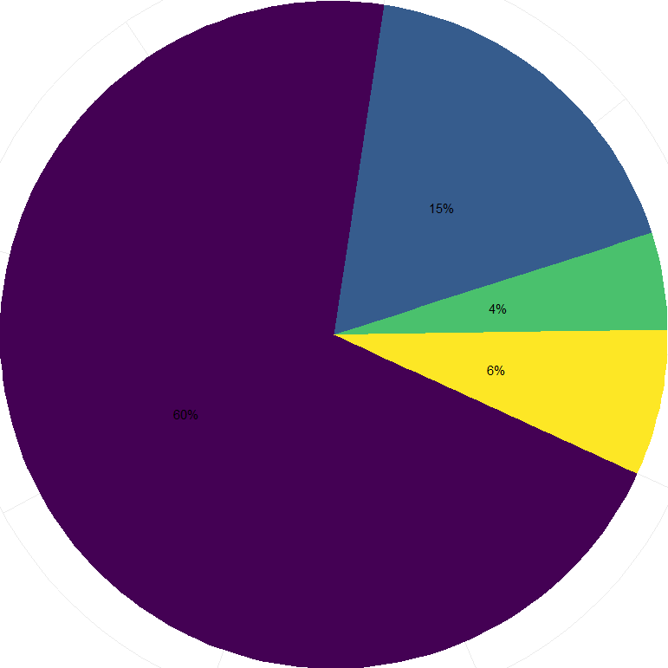
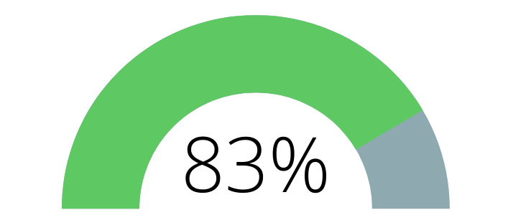
Understanding the Respondents
85% of Respondent come from…
15%
UK
Germany
Female
20%
UK
Male
79%
UK
4%
60%
USA
6%
Canada
Aged 20 - 39 years old

Slide 6
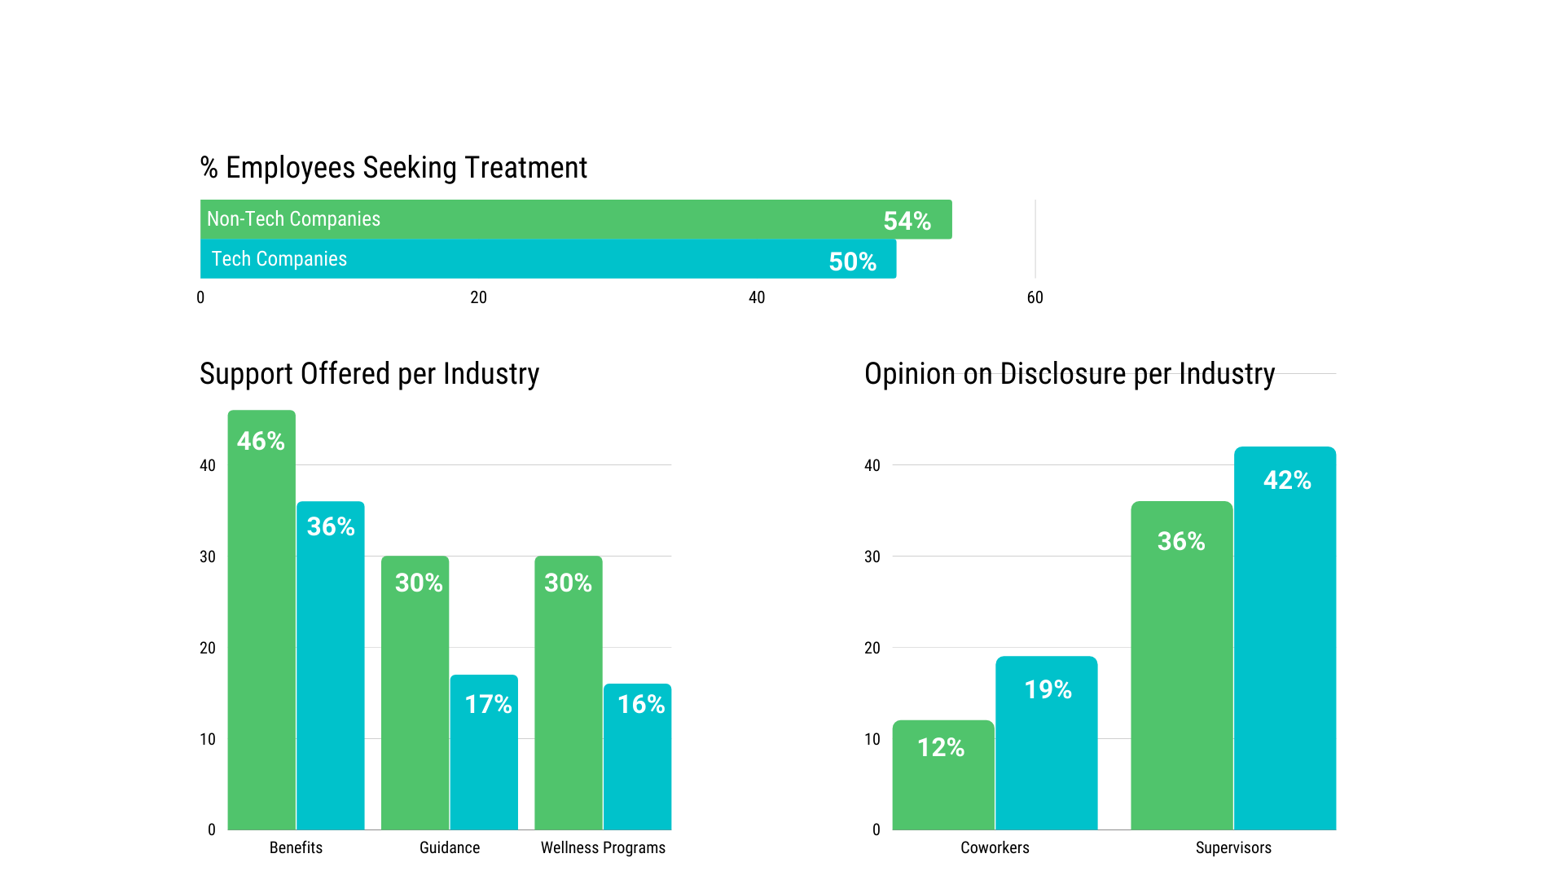
Comparison of Tech vs. Non-Tech Industries

Slide 7
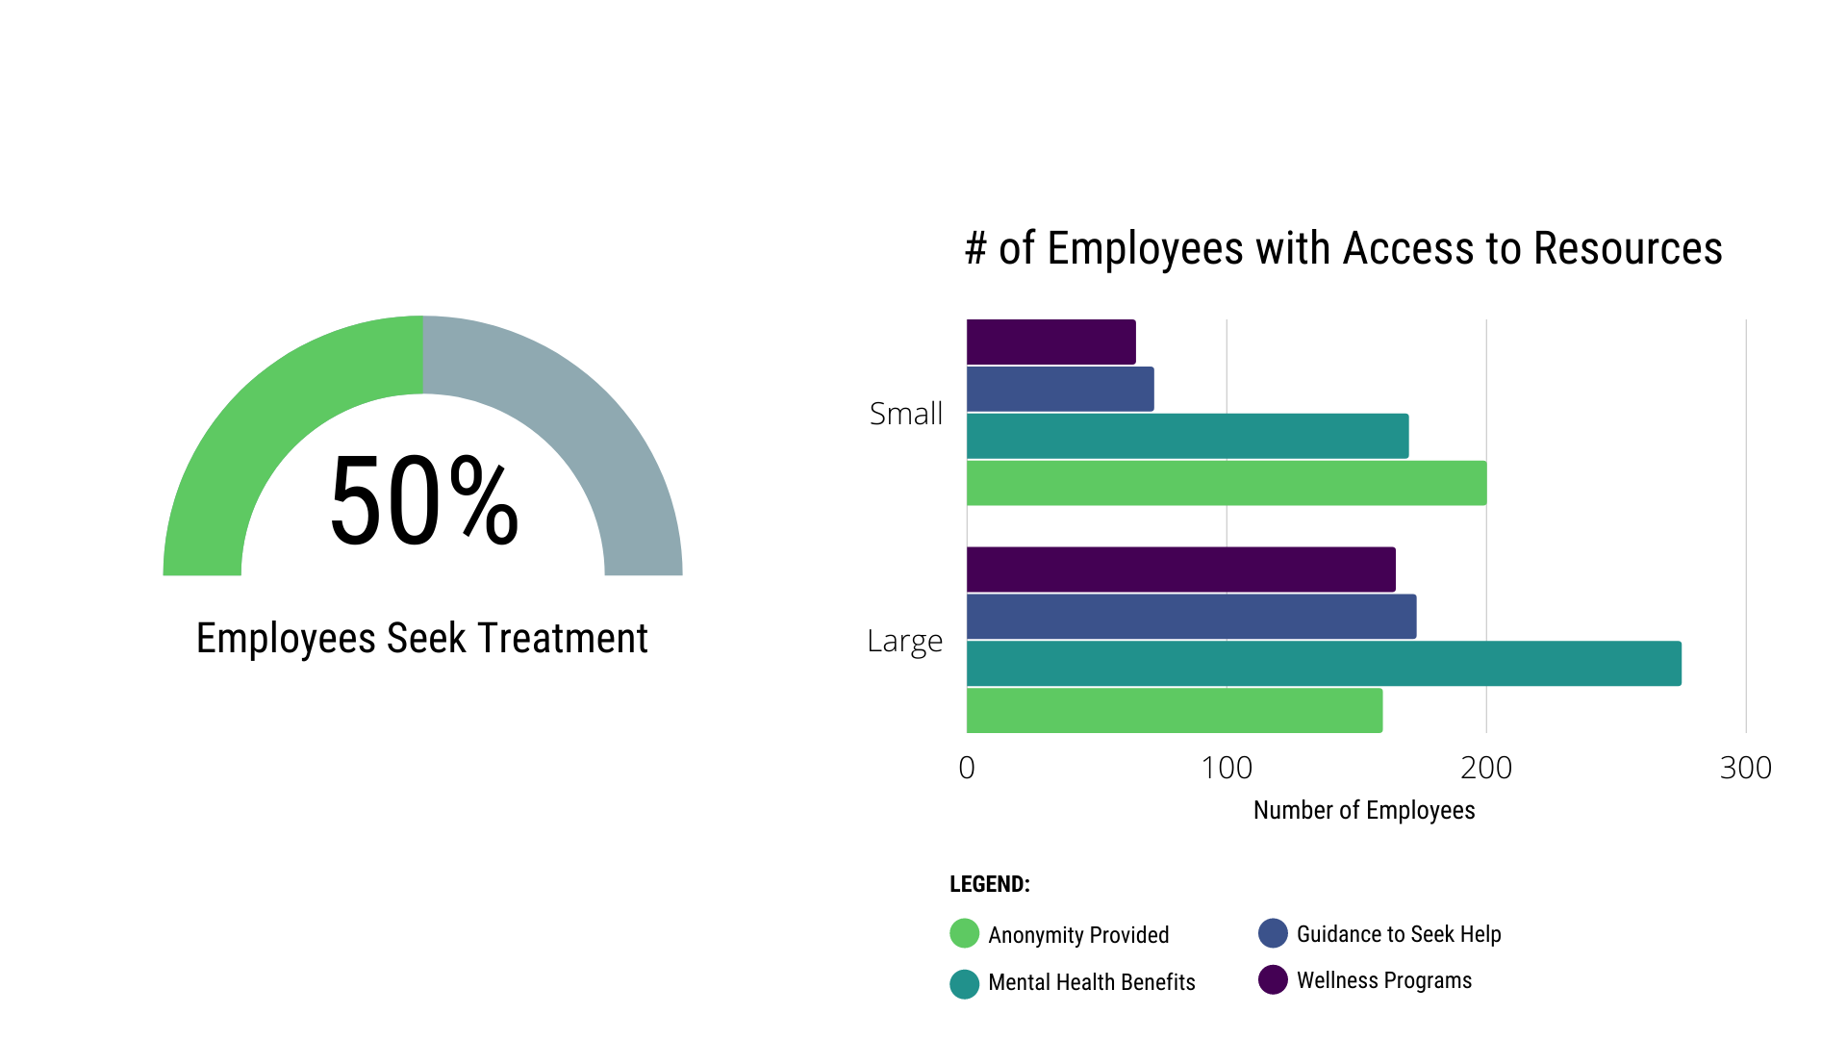
Comparison based on Company Size

Slide 8
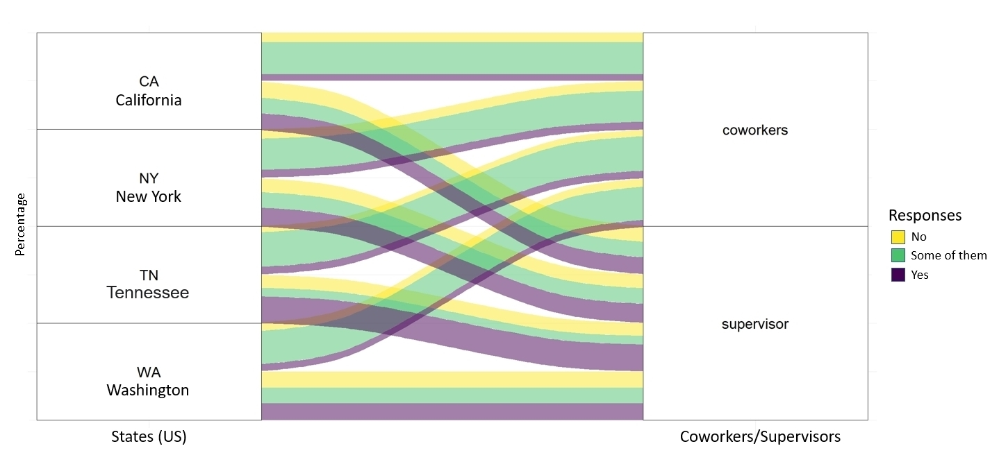
Who are employees more likely to open-up with ?
California
Coworkers
New York
Tennessee
Supervisors
Washington

Slide 9
Factors affecting mental health of employees

Slide 10
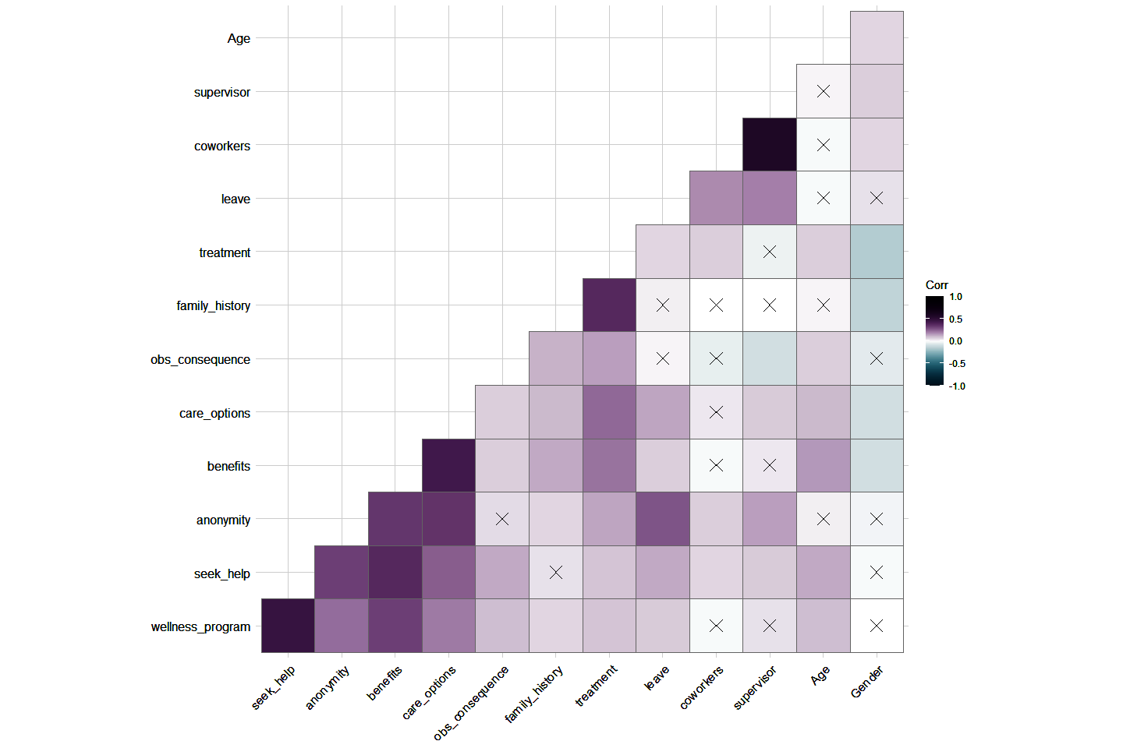
What factors are correlated?

Slide 11
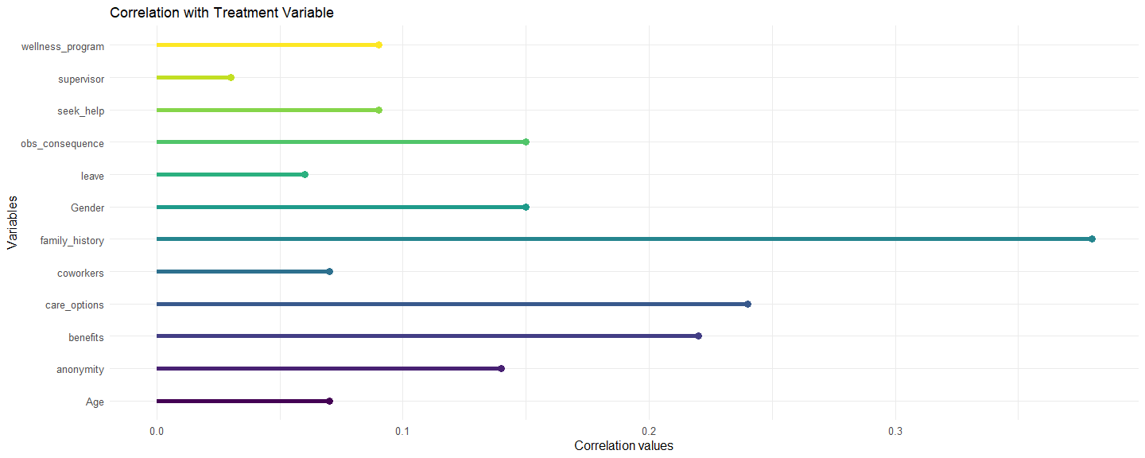
Impact on whether people seek treatment
Wellness Programs
Supervisors
Seek Help
Obs. Consequences
Leave
Gender
Family History
Coworkers
Care Options
Benefits
Anonymity
Age
0
0.1
0.2
0.3
Correlation Values

Slide 12
Analyzing Employee & Employer Mindset in Depth

Slide 13
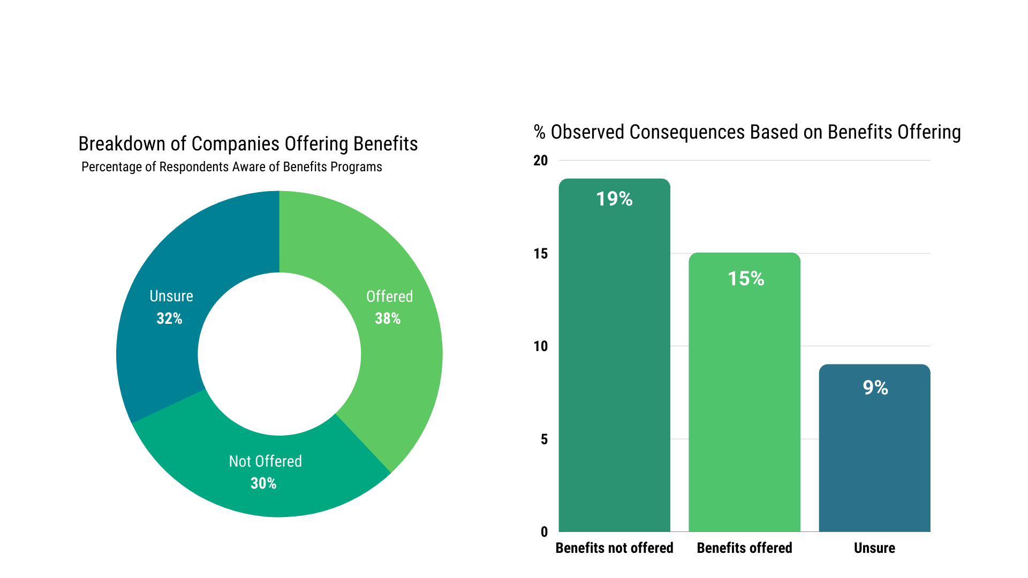
Comparison based on Benefits Offerings

Slide 14
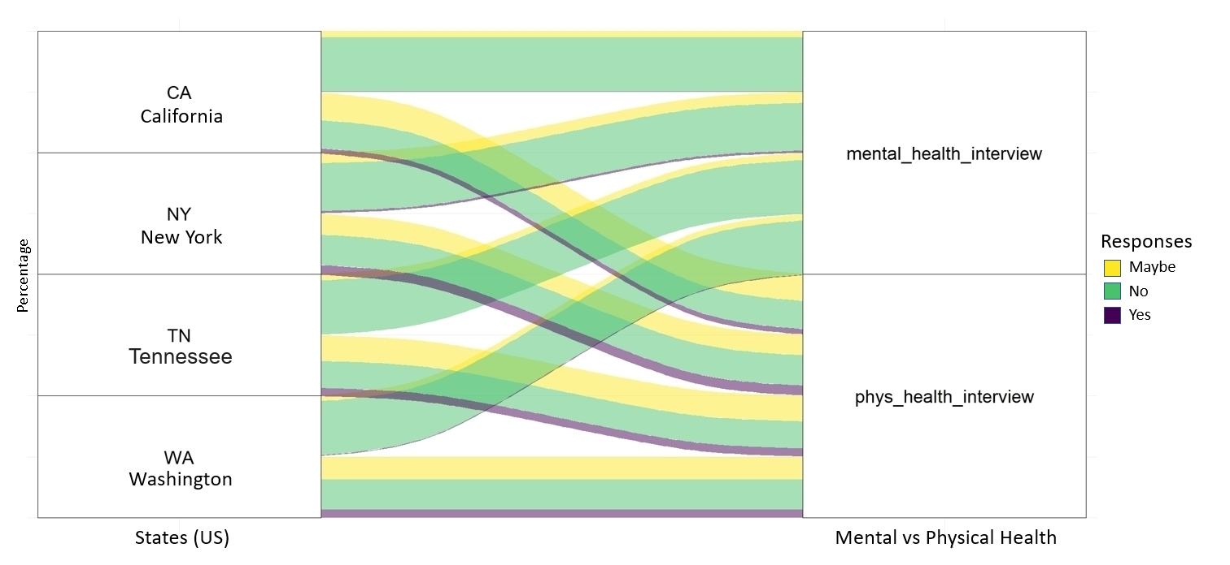
Would employees talk about mental health in an interview?
California
Mental Health
New York
Tennessee
Physical Health
Washington

Slide 15
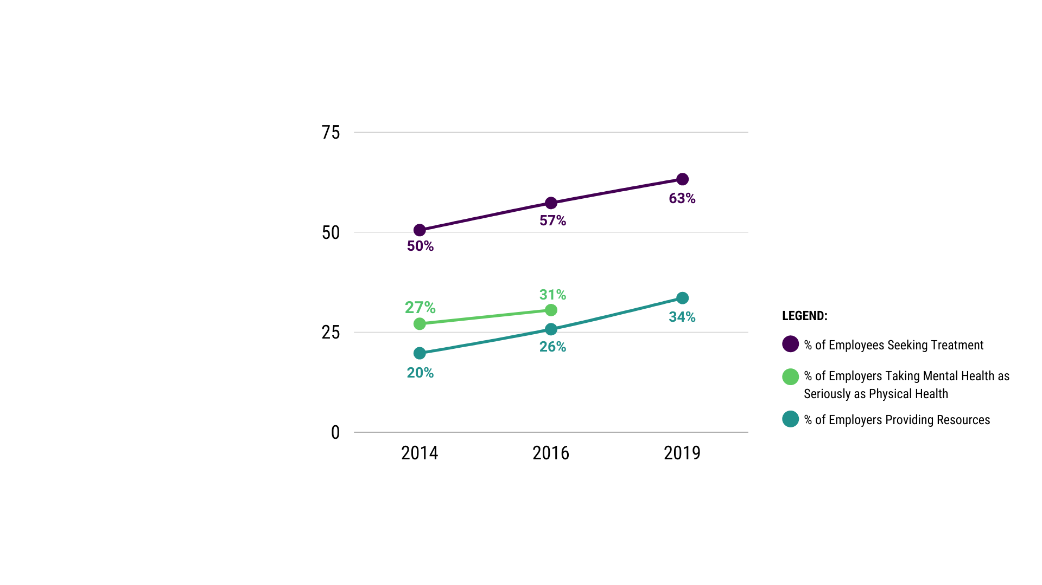
TREND on Attitude Towards Mental Health in the Workplace

Slide 16

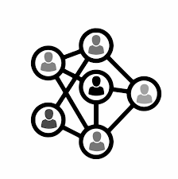



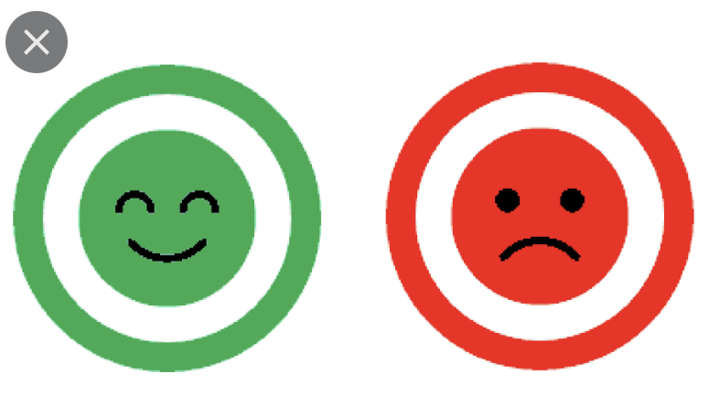
Sentiment of Comments
Most mentioned words:
Health
Mental
Employer
Issues
Company
All Genders &
20 - 60+ Age Range
18 - 19 Age Range

Slide 17
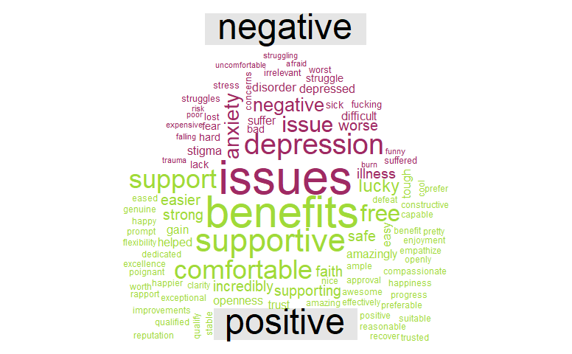
Sentiment of Comments

Slide 18


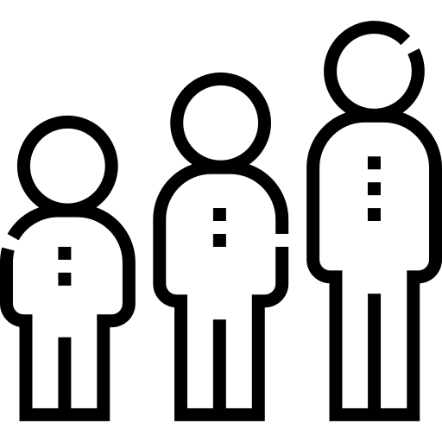
Conclusion
Mental health getting more stigmatised in the workplace
Employees are opening up to discuss & getting mental health
issues treated
Majority of employees have negative sentiments towards
mental health

Slide 19
Thank You!
Mental health is often missing from public health debates of any kind even though its critical to wellbeing.”
- Diane Abbott

Slide 20
References
Dataset: https://osmihelp.org/research
Supporting Information: https://hbr.org/2021/10/its-a-new-era-for-mental-health-at-work

Slide 21
